Slide 1
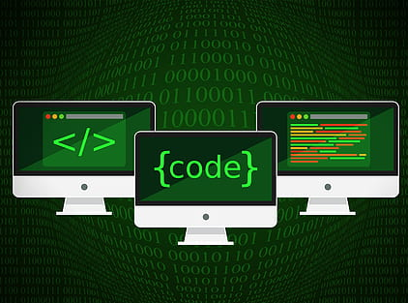
Unit 5
Server Side Scripting(PHP)

Slide 2
Introduction
What is PHP?
PHP (Hypertext Preprocessor) is a widely-used open source general-purpose server side scripting language that is especially suited for web development and can be embedded into HTML.

Slide 3
PHP's Place in the Web World
PHP is a programming language that's used mostly for building web sites. Instead of a PHP program running on a desktop computer for the use of one person, it typically runs on a web server and is accessed by lots of people using web browsers on their own computers. This section explains how PHP fits into the interaction between a web browser and a web server.
When you sit down at your computer and pull up a web page using a browser such as Internet Explorer or Mozilla, you cause a little conversation to happen over the Internet between your computer and another computer.

Slide 4
What's So Great About PHP?
PHP Is Free (as in Money)
You don't have to pay anyone to use PHP. There are no licensing fees, support fees, maintenance fees, upgrade fees, or any other kind of charge.
PHP Is Free (as in Speech)
As an open source project, PHP makes its innards available for anyone to inspect.
PHP Is Cross-Platform
You can use PHP with a web server computer that runs Windows, Mac OS X, Linux, Solaris, and many other versions of Unix.

Slide 5
Continue..
PHP Is Widely Used
As of March 2004, PHP is installed on more than 15 million different web sites.
PHP Hides Its Complexity
You can build powerful e-commerce engines in PHP that handle millions of customers.
PHP Is Built for Web Programming
Unlike most other programming languages, PHP was created from the ground up for generating web pages.

Slide 6
PHP Syntax
PHP code starts with <?php and ends with ?>
Every PHP statements end with a semicolon(;)
PHP code save with .php extension
PHP contain some HTML tag and PHP code
You can place PHP code anywhere in your document

Slide 7
PHP Syntax
Start and End Tags
The above example uses <?php as the PHP start tag and ?> as the PHP end tag. The PHP interpreter ignores anything outside of those tags. Text before the start tag or after the end tag is printed with no interference from the PHP interpreter.
<?php
//statements or blocks
?>
PHP can support multiple start and end tags. Each start tag must be closed by its own end tags.

Slide 8
Comments
Example: Single-line comments with // or #
// This line is a comment
print "Smoked Fish Soup ";
print 'costs $3.25.';
# Add another dish to the menu
print 'Duck with Pea Shoots ';
print 'costs $9.50.';
// You can put // or # inside single-line comments

Slide 9
Example: Multiline comments
/* We're going to add a few things to the menu:
- Smoked Fish Soup
- Duck with Pea Shoots
- Shark Fin Soup
*/

Slide 10
Data Type
PHP has total of 8 data types which we used to construct our variables.
Integers are whole number without a decimal point.
Doubles are floating point numbers like 3.1415, 2.50
Boolean have only two possible value either true or false.
NULL is special type that only has one value: NULL
Strings are sequence of characters like php supports string operations
Arrays are named and indexed collection of other values.
Object are instance of program defined classes which can package up both other kinds of values and functions that are specified to the class.
Resources are special variables that hold references to resources external to php (such as database connection).

Slide 11
String Example
<?php
print 'I would like a bowl of soup.';
print 'chicken';
print '06520';
print '"I am eating dinner," he growled.';
?>
Output:
I would like a bowl of soup.chicken06520"I am eating dinner," he growled.

Slide 12
The output of those four print statements appears all on one line. No lines breaks are added by print. You may also use echo used in some PHP programs to print text. It works just like print. The single quotes aren't part of the string. They are delimiters, which tell the PHP interpreter where the start and end of the string is.

Slide 13
If you want to include a single quote inside a string surrounded with single quotes, put a backslash (\) before the single quote inside the string:
<?php
print 'We\'ll each have a bowl of soup.';
?>
Output:
We'll each have a bowl of soup.

Slide 14
The backslash tells the PHP interpreter to treat the following character as a literal single quote instead of the single quote that means "end of string." This is called escaping, and the backslash is called the escape character. An escape character tells the system to do something special with the character that comes after it. Inside a single-quoted string, a single quote usually means "end of string." Preceding the single quote with a backslash changes its meaning to a literal single quote character.

Slide 15
You can also delimit strings with double quotes. Double-quoted strings are similar to single-quoted strings, but they have more special characters.
Special characters in double-quoted strings
Character | Meaning
\n | Newline(ASCII 10)
\r | Carriage return (ASCII 13)
\t | Tab (ASCII 9)
\\ | \
\$ | $
\" | "
\0..\777 | Octal (Base 8) Number
\x0..\xFF | Hexadecimal (Base 16) Number

Slide 16
The biggest difference between single-quoted and double-quoted strings is that when you include variable names inside a double-quoted string, the value of the variable is substituted into the string, which doesn't happen with single-quoted strings.
For example, if the variable $user held the value Bill, then 'Hi $user' is just that: Hi $user. However, "Hi $user" is Hi Bill.

Slide 17
Constant
A constant is a name or an identifier for a simple value. A constant value cannot change during the execution of the script. By default a constant is a case-sensitive. By convention, constant identifiers are always uppercase.

Slide 18
Constant() function
As indicated by name, this function will return the value of the constant.
Example:
<?php
define ("MINSIZE",50);
echo MINSIZE;
echo constant ("MINSIZE"); //same thing as above
?>
Output:
?

Slide 19
Numbers
Numbers in PHP are expressed using familiar notation, although you can't use commas or any other characters to group thousands. You don't have to do anything special to use a number with a decimal part as compared to an integer.

Slide 20
Example: Numbers
print 56;
print 56.3;
print 56.30;
print 0.774422;
print 16777.216;
print 0;
print -213;
print 1298317;
print -9912111;
print -12.52222;
print 0.00;

Slide 21
Using Different Kinds of Numbers
Internally, the PHP interpreter makes a distinction between numbers with a decimal part and those without one. The former are called floating-point numbers and the latter are called integers.
Floating-point numbers take their name from the fact that the decimal point can "float" around to represent different amounts of precision.

Slide 22
Boolean
Boolean data types are used in conditional testing. Hold only two values, either TRUE(1) or FALSE(0).
Successful events will return true and unsuccessful events return false. NULL type values are also treated as false in Boolean.
Apart from NULL, 0 is also considered false in boolean. If a string is empty then it is also considered false in boolean data type.
<?php
if(TRUE)
echo "This condition is TRUE";
if(FALSE)
echo "This condition is not TRUE";
?>

Slide 23
Array
Array is a compound data type that can store multiple values of the same data type. Below is an example of an array of integers. It combines a series of data that are related together.
Indexed array:
<?php
$numarr = array( 10, 20 , 30);
echo "First Element: $numarr[0]\n";
echo "Second Element: $numarr[1]\n";
echo "Third Element: $numarr“s;
?>

Slide 24
Array
Associative array: Associative arrays are arrays that use named keys that you assign to them.
<?php
$age = array(“Aman”=>”21”,”Binita”=>”19”,”Chandan”=>”21”);
// or you can declase array element by $age[‘Binita’]=“19”;
echo “Binita is “. $age[‘Binita’]. ”years old”
?>
Foreach loop for displaying elements of associative array with key and value.
foreach($age as $x=>$x_value)
{
echo “Key=”.$x.”, Value=“.$x_value;
echo “<br>”
}
?>

Slide 25
Object
Objects
Objects are defined as instances of user-defined classes that can hold both values and functions and information for data processing specific to the class. This is an advanced topic and will be discussed in detail in further articles. When the objects are created, they inherit all the properties and behaviors from the class, having different values for all the properties.
Objects are explicitly declared and created from the new keyword.
<?php
class Fruit {
// Properties
public $name;
public $color;
// Methods
function set_name($name) {
$this->name = $name;
}
function get_name() {
return $this->name;
}
}
$obj=new Fruit();
$obj.set_name(‘Grape’);
$obj.get_name();
?>

Slide 26
Variables
Variables hold the data that your program manipulates while it runs, such as information about a user that you've loaded from a database or entries that have been typed into an HTML form. In PHP, variables are denoted by $ followed by the variable's name. To assign a value to a variable, use an equals sign (=). This is known as the assignment operator.

Slide 27
Examples:
$plates = 5;
$dinner = 'Beef Chow-Fun';
$cost_of_dinner = 8.95;
$cost_of_lunch = $cost_of_dinner;

Slide 28
Acceptable variable names
$size
$drinkSize
$my_drink_size
$_drinks
$drink4you2

Slide 29
Unacceptable variable names
Variable name Flaw
$2hot4u Begins with a number
$drink-size Unacceptable character: -
$drinkmaster@example.com Unacceptable characters: @ and .
$drink!lots Unacceptable character: !
$drink+dinner Unacceptable character: +

Slide 30
Variable names
Variable names are case-sensitive. This means that variables named $dinner, $Dinner, and $DINNER are separate and distinct.

Slide 31
Operating on Variables
Arithmetic and string operators work on variables containing numbers or strings just like they do on literal numbers or strings.

Slide 32
Example: Operating on variables
<?php
$price = 3.95;
$tax_rate = 0.08;
$tax_amount = $price * $tax_rate;
$total_cost = $price + $tax_amount;
$username = 'james';
$domain = '@example.com';
$email_address = $username . $domain;
print 'The tax is ' . $tax_amount;
print "\n"; // this prints a linebreak
print 'The total cost is ' .$total_cost;
print "\n"; // this prints a linebreak
print $email_address;
?>

Slide 33
Output:
The tax is 0.316
The total cost is 4.266
james@example.com

Slide 34
Example: Combined assignment and addition
// Add 3 the regular way
$price = $price + 3;
// Add 3 with the combined operator
$price += 3;
Output:
?

Slide 35
Example: Combined assignment and concatenation
$username = 'james';
$domain = '@example.com';
// Concatenate $domain to the end of $username the regular way
$username = $username . $domain;
// Concatenate with the combined operator
$username .= $domain;
Output:
?

Slide 36
Example: Incrementing and decrementing
// Add one to $birthday
$birthday = $birthday + 1;
// Add another one to $birthday
++$birthday;
// Subtract 1 from $years_left
$years_left = $years_left - 1;
// Subtract another 1 from $years_left
--$years_left;
Output:
?

Slide 37
Putting Variables Inside Strings
Example: Variable interpolation
<?php
$email = 'jacob@example.com';
print "Send replies to: $email";
?>
Output:
Send replies to: jacob@example.com

Slide 38
define() function
To define a constant, we have to use define() function and to retrieve the value of a constant we have to simply specify it's name.

Slide 39
Arithmetic Operators
Some basic operations between numbers are shown in example below.

Slide 40
Example: Math operations
print 2 + 2;
print 17 - 3.5;
print 10 / 3;
print 6 * 9;
print 17 % 3;
Output:
4
13.5
3.3333333333333
54
2

Slide 41
Operator:
Arithmetic Operator
Comparison Operator
Logical or Relational Operator
Assignment Operator
Conditional or ternary Operator

Slide 42
Arithmetic Operator
Assume variable A holds 10 and variable B holds 20 then.
Operator | Description | Example
+ | Adds two operands from the first | A+B will give 30
- | Subtract second operand from the first | A-B will give -10
* | Multiply both operands | A*B will give 200
/ | Divide the numerator by denominator | B/A will give 2
% | Modulus operator & remainder after an integer division | B%A will give 0
++ | Increment operator increases integer value by one | A++ will give 11
-- | Decrement operator decreases integer value by one | A—will give 9

Slide 43
Comparison Operator
Assume variable A holds 10 and variable B holds 20 then.
Operator | Description | Example
== | Checks if the values of two operands are equal or not if yes then condition becomes true. | (A==B) is not true
!= | Checks if the values of two operands are equals or not, if not equal the condition becomes true. | (A!=B) is true
> | Checks if the value of left operand is greater than the value of right operand, if yes then condition becomes true. | (A>B) is not true
< | Check if the value of left operand is less than the value of right operand, if yes then condition becomes true. | (A<B> is true
>= | Check if the value of left operand is greater than or equal to the value of right operand, if yes then condition becomes true. | (A>=B) is not true
<= | Check if the value of left operand is less than or equal to the value of right operand, if yes then condition becomes true. | (A<=B) is true

Slide 44
Logical Operator
Assume variable A holds 10 and variable B holds 20 then.
Operator | Description | Example
AND | It is called logical AND operator. If both the operands are true the condition becomes true. | (A AND B) is true
OR | It is called logical OR operator. If any of the two operands are non-zero then condition becomes true. | (A OR B) is true
&& | It is called logical AND operator. If the both the operands are non zero then the condition becomes true. | (A && B) is true
|| | It is called logical OR operator. If any of the two operands are non-zero then condition becomes true. | (A || B) is true
! | It is called logical NOT operator, use to reverse the logical state of its operand. If a condition is true then logical NOT operator will make false. | !(A && B) is false

Slide 45
Assignment Operator
Operator | Description | Example
= | Simple assignment operator, assign values from right side operands to left side operands. | C=A+B will assign to value of A+B into C.
+= | Add and assignment operator, adds right operand to the left operand and assign the result to left operand. | C+=A is equivalent to C=C+A
-= | Subtract and assignment operator, subtract right operand from the left operand and assign the result to left operand | C-=A is equivalent to C=C-A
*= | Multiply and assignment operator, multiply right operand from the left operand and assign the result to left operand | C*=A is equivalent to C=C*A
/= | Divide and assignment operator, divide right operand from the left operand and assign the result to left operand | C/=A is equivalent to C=C/A
%= | Modulus and assignment operator, modulus right operand from the left operand and assign the result to left operand | C%=A is equivalent to C=C%A

Slide 46
Control Structure
If statement
If else statement
Switch statement
***Same as javascript

Slide 47
Loops
For Loop
While loop
Do while loop
**same as javascript
Foreach loop: example mentioned in previous slide (array)

Slide 48
PHP forms
Forms are essential components of a website used register a new account, sign in or login to the account. Using a form in a PHP program is a two step activity. Step one is to display the form which involves constructing HTML tags and UI’s. Step two is processing the submitted for information submitted by the user.
Accessing Form Elements:
The PHP superglobals $_GET and $_POST are used to collect form data. $_GET is an array of variables passed to the current script via the URL parameters. $_POST is an array of variables passed to the current script via the HTTP POST method

Slide 49
$_GET method
Information sent from a form with the GET method is visible to everyone(all variable names and values are displayed in the URL).
GET also has limits on the information to send. The limitation is about 2000 characters. GET may be used for sending non-sensitive data. GET should never be used for sending passwords or other sensitive information.

Slide 50
$_POST method
Information sent from a form with the POST method is invisible to others(all names/values are embedded within the body of the HTTP request) and has no limits on the amount of information to be sent. POST may be used for sending sensitive data. Developers prefer POST for sending form data.

Slide 51
Form validation
Similar to Javascript. Study yourself

Slide 52
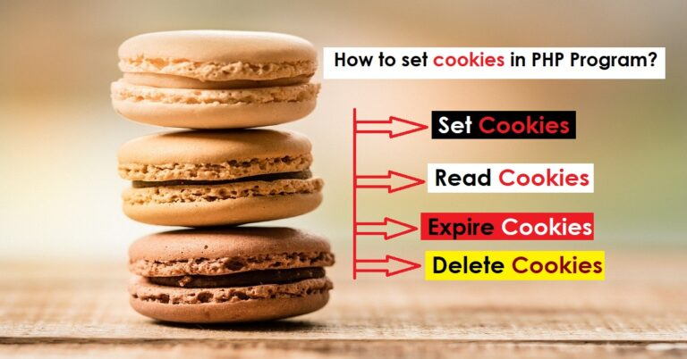
Cookies

Slide 53
Cookies
Cookie: A cookie is variable that is stored on the visitors computer. Each time the same computer requests a page with a browser it will sent the cookie too. With PHP, we can both create and retrieve cookie values.
*Creating cookies with PHP
Syntax: setcookie(name,value,expire,path,domain,…);
Only name parameter is compulsary. And other are optional.
To delete a cookie, we use the setcookie()function with an expiration date in the past.

Slide 54
Cookies
Example: Creating and retrieve a cookie
<?
$cookie_name=“username”;
$cookie_value=“John Doe”;
setcookie($cookie_name,$cookie_value,time()+(86400*30),”/”);
If(!isset($_COOKIE[$cookie_name])){
echo $cookie_name.”is not set”;
}
else{
echo $cookie_name.”is set ”;
}
?>

Slide 55
Session
A session is a way to store information(in variables) to be used across multiple pages. Unlike a cookie, the information is not stored on the users computer rather session is stored in server. Session variables hold information about one single user and are available to all pages in one application.
# Why do we need session?
When we work with an application, we open it, do some changes, and then we close it. This is much like session. The computer knows who we are. It knows when we start the application and when we end. But on the internet there is one problem: the web server does not know who we are or what er do, because HTTP address doesn’t maintain state. Session variable solve this problem by storing user information to be used across multiple pages. By, default, session variables last until the user closes the browser.

Slide 56
Session
Uses of Session:
Session can help to uniquely identify each client from another
Session is secure and transparent from the user
It is easy to implement and we can store any kind of object
It helps to maintain user state and data all over the application
It stores client data separately
Starting PHP Session:
A PHP session is easily started by making a call to the session_start() function. Session variables are stored in associative array called $_SESSION[]. We make use of isset() function to check if session variable is already set or not.

Slide 57
Session
Example: Starting session and setting session values
<?php
//start the session
session_start();
//set session variables
$_SESSION[“username”]=“john”;
$_SESSION[“email”]=“lucky@gmail.com”;
echo “Session variables are set”;
?>
** session_unset() or session_destroy() is used to remove all global variables and destroy session.

Slide 58
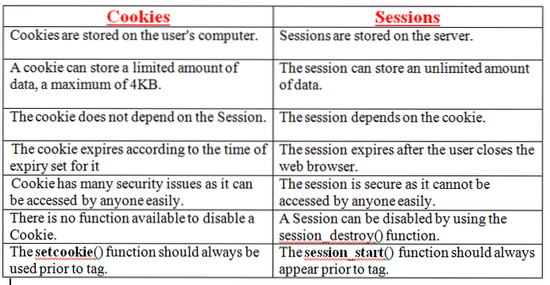

Slide 59



Introduction to PHP Frameworks
1.CodeIgniter:
CodeIgniter is a powerful PHP framework with a very small footprint, built for developers who need a simple and elegant toolkit to create full featured web applications. It works on MVC(Model View Controller) framework
Installation steps in book/uses
2. Laravel: Laravel is a web application framework with expressive, elegant syntax. Laravel attempts to take the pain out of development by easing common tasks used in the majority of wb projects such as authentication, routing, sessions and caching. Laravel is a powerful MVC PHP framework.
Installation steps in book/uses
3.Wordpress:
Wordpress is a free and open source content management system.(CMS) based on PHP and MYSQL. It is the most widely used CMS software in the world. Wordpress is an industry leading website and blog building tool. There is an entire community of Wordpress users and developers who are able to assist one another. User have countless options for free and paid plugins and site templates for their use in creating their site.

Slide 60
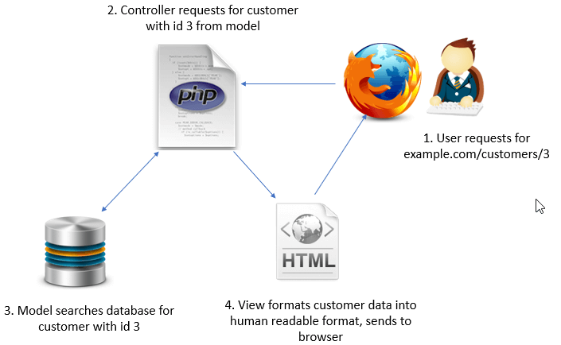
MVC architecture

Slide 61
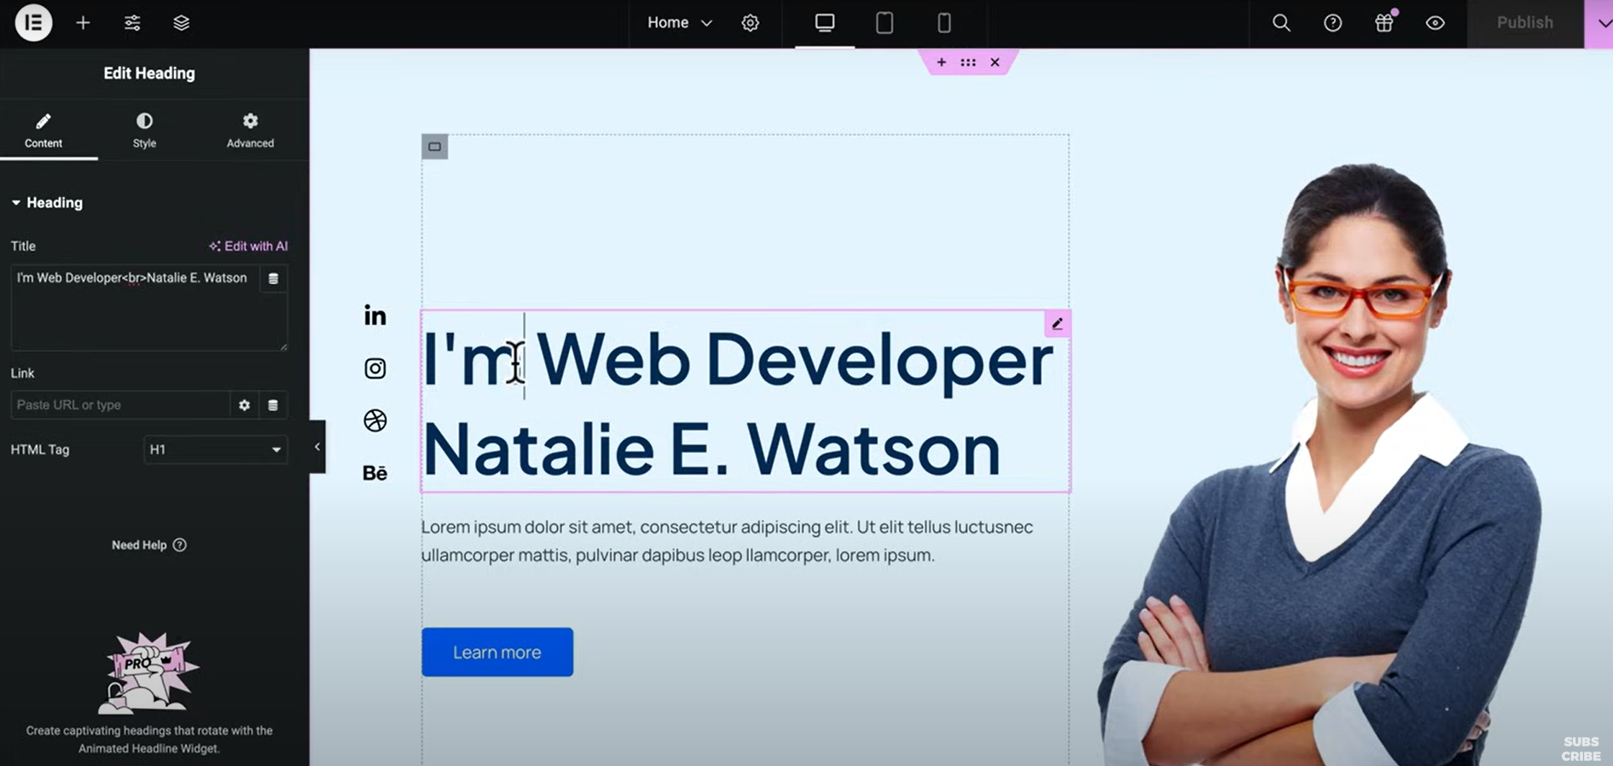
WordPress interface

Slide 62
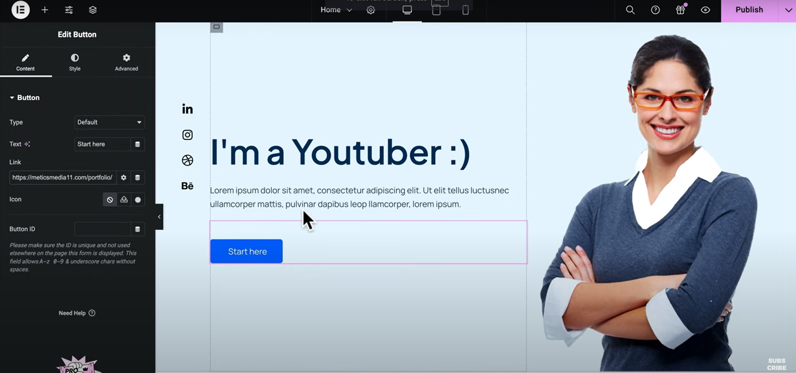
WordPress interface

Slide 63
Assignment
Define Class and Object in PHP
Define Events in PHP
Define PHP Superglobals. $_REQUEST $_SERVER

